Slide 1

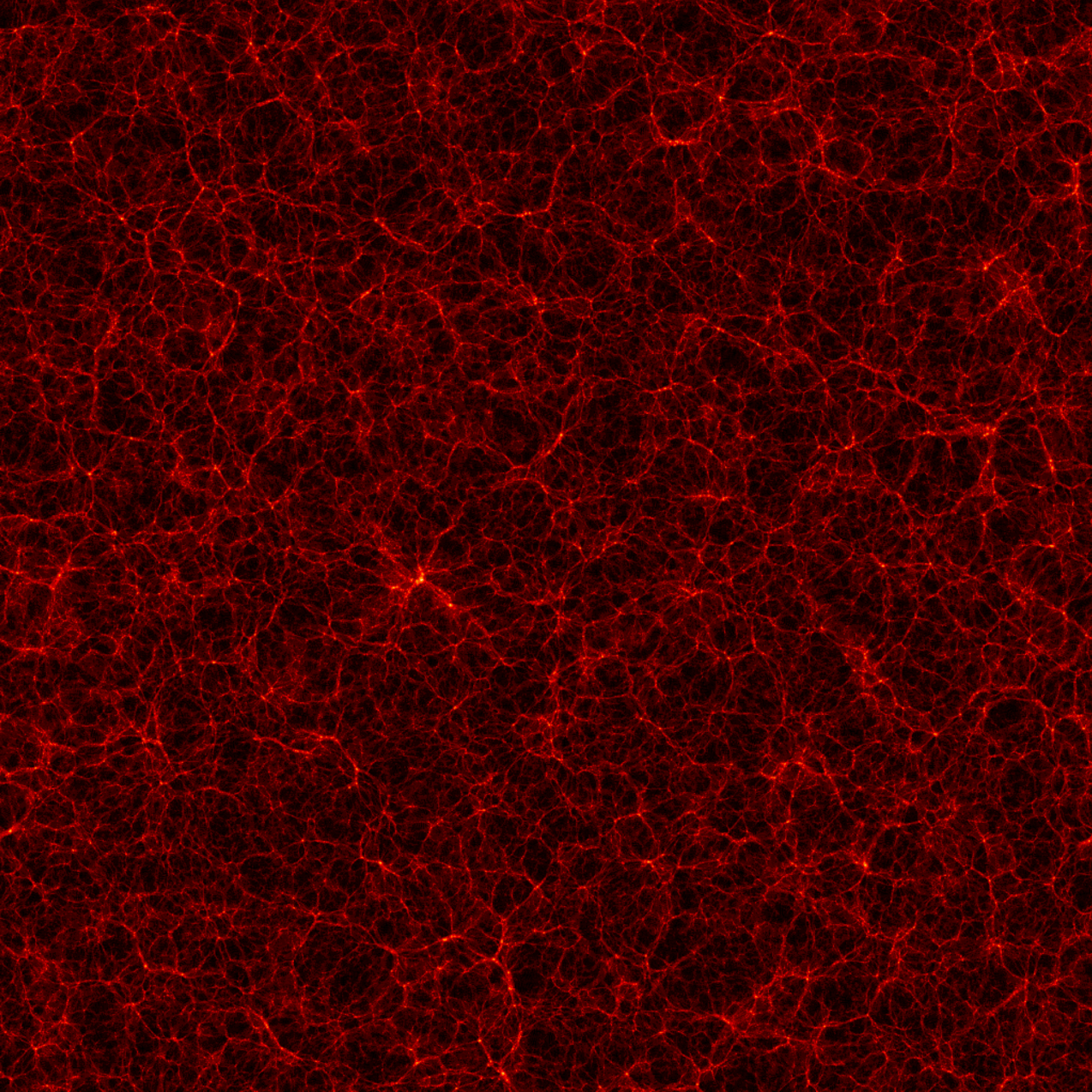
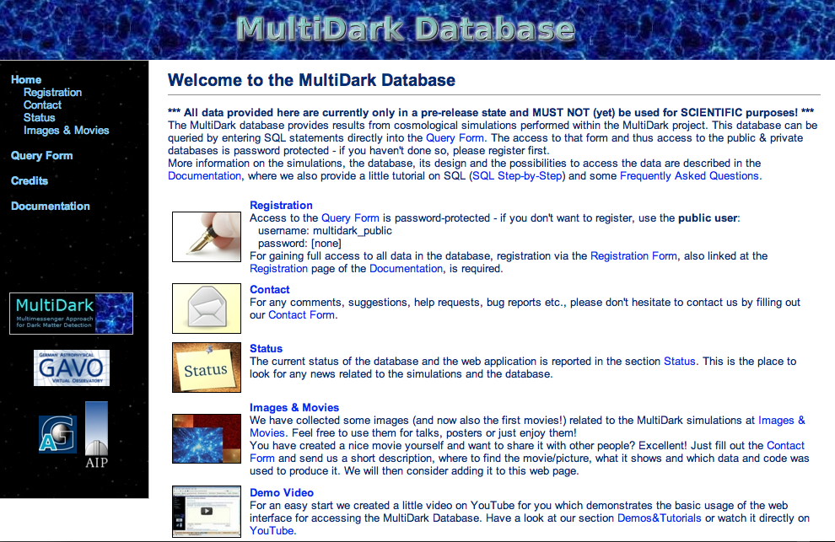
Clustering analysis using MultiDark halo abundance
F. Prada (IAA), S. E. Nuza (AIP), A. Klypin (NMSU), A. Sánchez (MPE), S. Gottloeber (AIP)
for the BOSS clustering WG, Project 73
First results!
1Gpc/h
First results!
www.multidark.org
DR1 on April 5th!
MultiDark Run 1
Cloudcroft BOSS coll. Meeting 03/11

Slide 2
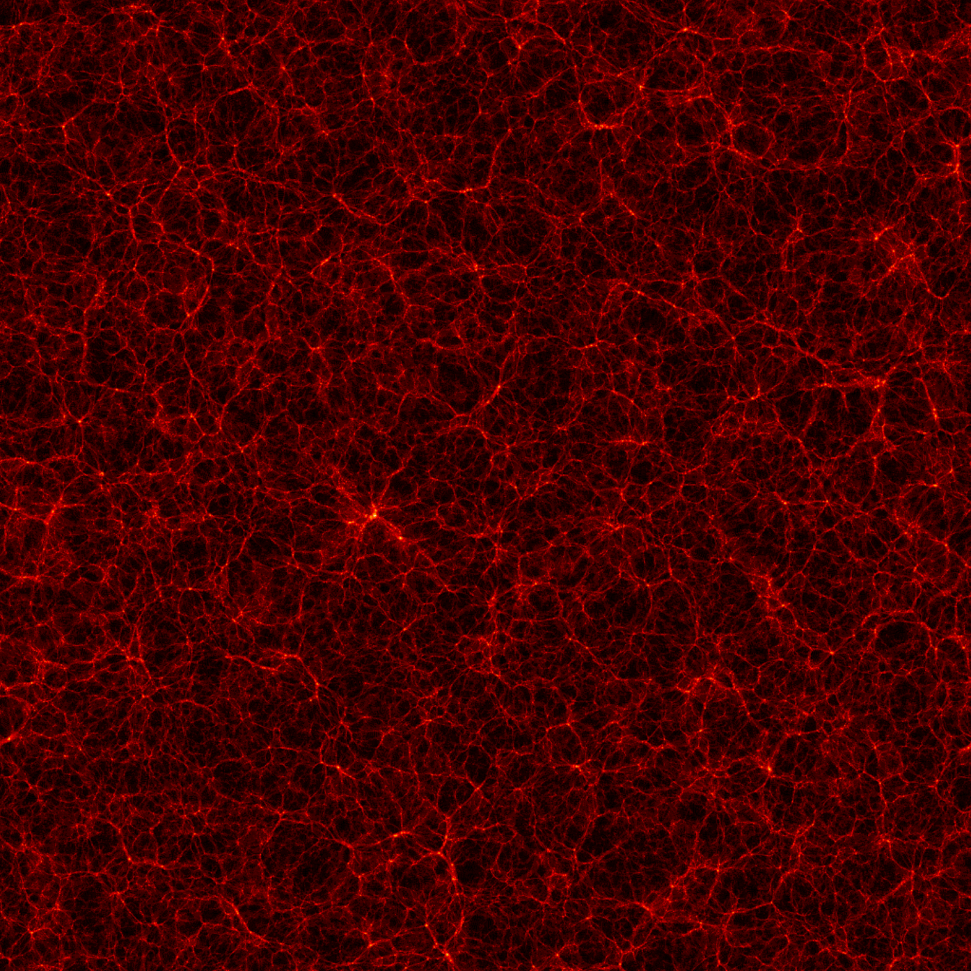
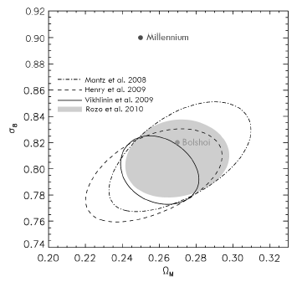
MULTIDARK suite of simulations for BOSS studies
Mass function
Run with ART code by A. Klypin
1Gpc/h
1.5 10¹⁵ h⁻¹M_{sun}
L_{box}= 1000 h⁻¹ Mpc
N_{part}= 2048³
Force res.= 4kpc comov.
M_{part}=8.63 10⁹ h⁻¹ M_{sun}
MultiDark Run 1, Prada et al. 2011

Slide 3
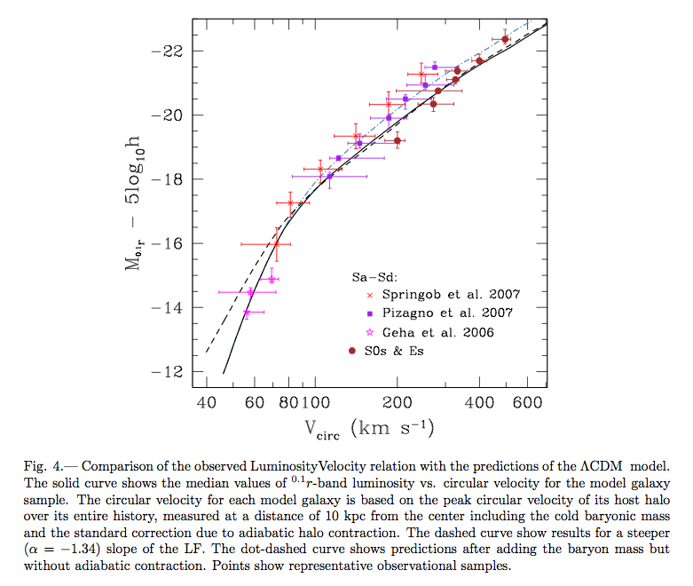
Velocity functions
The maximum of the halo circular velocity profile
V²_{max}=max[GM(<r)/r]
is a measure of the depth of the dark matter halo potential well and it is expected to correlate well with the baryonic component of galaxies such as the luminosity or stellar mass as followed from the Tully-Fisher relation. The maximum circular velocity at present, for dominant halos, and at the time of accretion, in the case of subhalos, gives a better match to model the observed luminosity dependence and evolution of galaxy clustering from high-z to the present (e.g. Conroy et al. 2006). Another example is the recent work by Trujillo-Gomez et al. 2010 where they provide LCDM predictions for basic statistics of galaxies: Luminosity– and Baryonic Mass--Velocity Relations, and Velocity Functions.
Comparison of the observed Luminosity-Velocity
Relation with the predictions of the LCDM model
(Trujillo-Gomez et al. 2010)

Slide 4
Velocity functions for Subhalos and Distinct Halos
Results from BDM halo finder
MultiDark @ z=0
Evolution

Slide 5
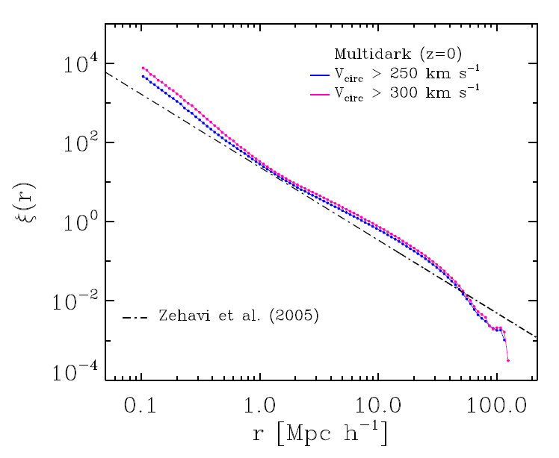
MultiDark real space correlation function @ z = 0
r = (x²+y²+z²)^{1/2}
* 1-halo and 2-halo terms clearly visible
* Simple halo abundance matching technique
to get the correct number density of objects
<n_{g}>=n_{h}(>V_{max})
* Consistent to clustering measures of the local
Universe

Slide 6
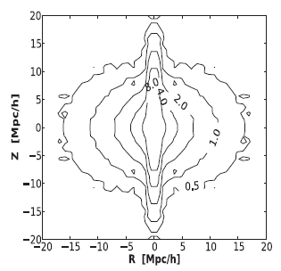
MultiDark 2D correlation function @ z =0.53
BOSS CMASS, White et al. (2011)
z z + v_{pec} * H⁻¹(t)
σ = (x² + y²)^{1/2}
π = (z²)^{1/2}
ξ(σ,π)
MultiDark
First results!
V_{circ}> 365 km s⁻¹
<n> ~ 3.5 x 10⁻⁴ h⁻³ Mpc³

Slide 7
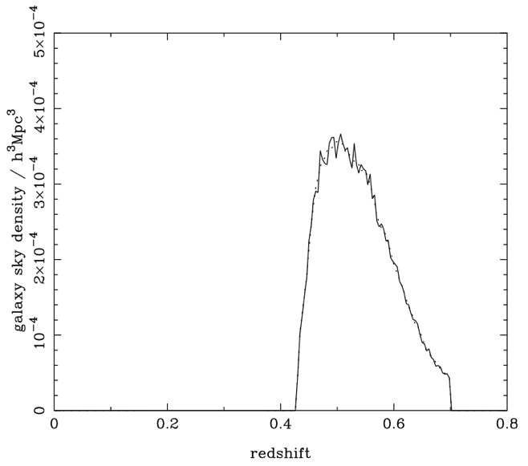

MultiDark projected correlation function at z = 0.53 compared with most recent BOSS estimation from A. Sánchez for CMASS sample
* BOSS estimation of the projected CF
for 0.4 < z < 0.7 CMASS sample
* In practice, the 2D CF is
integrated up to ~100-150 h⁻¹ Mpc
First results!

Slide 8
Redshift space correlation function
First results!

Slide 9
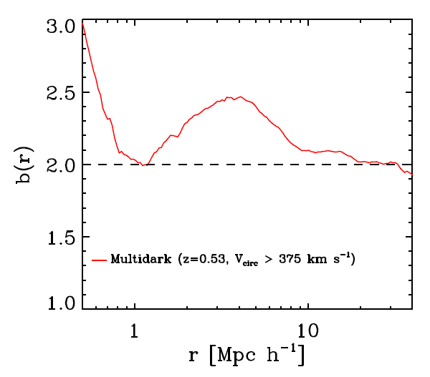
Galaxy BIAS @ z=0.53
Preliminary!
b²(r) = ξ_{g}(r) / ξ_{dm}(r)
* Preliminary estimation
indicates a bias of b ~ 2
for scales 10 < r < 40 h⁻¹ Mpc

Slide 10
Satellite Fraction @ z=0.53
* Using the subhalo sample we can study satellite statistics within dark matter halos
V_{circ} = 365 km s⁻¹

Slide 11
Plans for mock galaxy catalogs & new simualtions

Slide 12

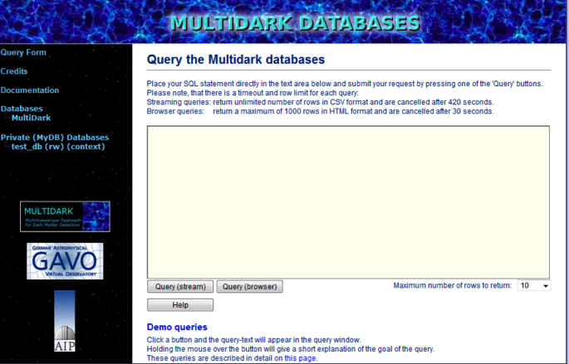
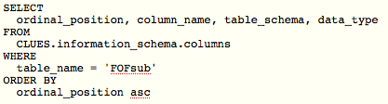
MultiDark Database
collaboration with Astrophysical Institute Potsdam (AIP), supported by GAVO
Database for MULTIDARK simulations will include:
  halo + galaxy catalogues
  (positions, velocities, properties)
  kinematic and density profiles
  snapshots of simulations (particle selection)
design similar to Millennium
Simulation DB
compliant to international VO
(virtual observatory) standards
Web interface:
www.multidark.org
  direct access via SQL queries
  store results of queries in own
  database (registered users)
  history of previous queries
  on-line documentation

Slide 13
www.multidark.org

Slide 14
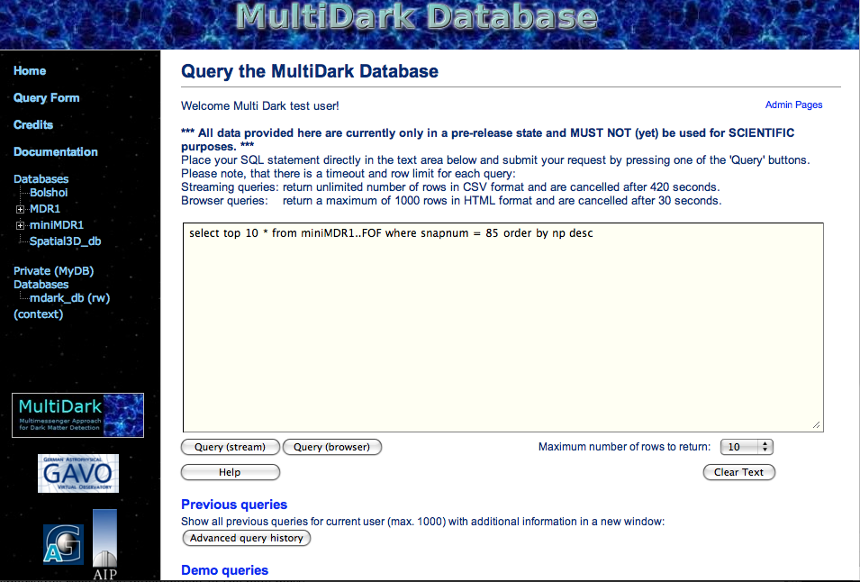
www.multidark.org

Slide 15
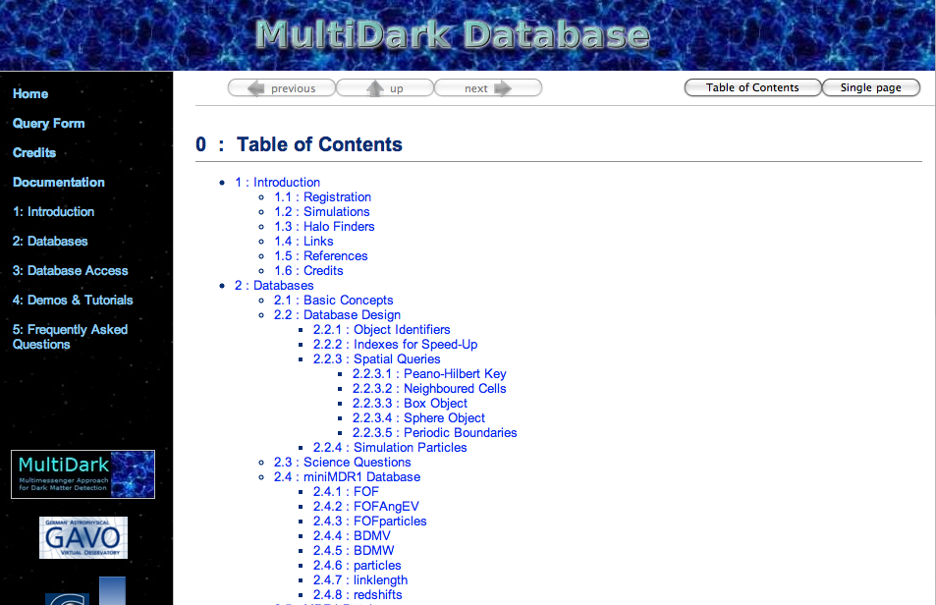
www.multidark.org

Slide 16
Thank you!

